Slide 1
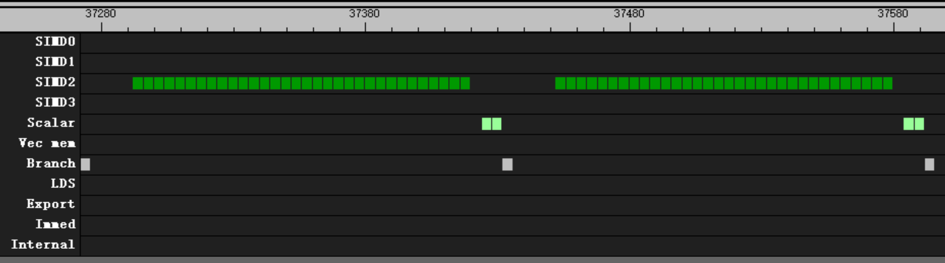
valu
1 wave per CU
60 group
32 valu per loop
16 clk after s_branch
4 clk after all valu
v_mov_b32 v[v_test+ 0], 0
v_mov_b32 v[v_test+ 1], 0
v_mov_b32 v[v_test+ 2], 0
v_mov_b32 v[v_test+ 3], 0
v_mov_b32 v[v_test+ 4], 0
v_mov_b32 v[v_test+ 5], 0
v_mov_b32 v[v_test+ 6], 0
v_mov_b32 v[v_test+ 7], 0
v_mov_b32 v[v_test+ 8], 0
v_mov_b32 v[v_test+ 9], 0
v_mov_b32 v[v_test+10], 0
v_mov_b32 v[v_test+11], 0
v_mov_b32 v[v_test+12], 0
v_mov_b32 v[v_test+13], 0
v_mov_b32 v[v_test+14], 0
v_mov_b32 v[v_test+15], 0

Slide 2
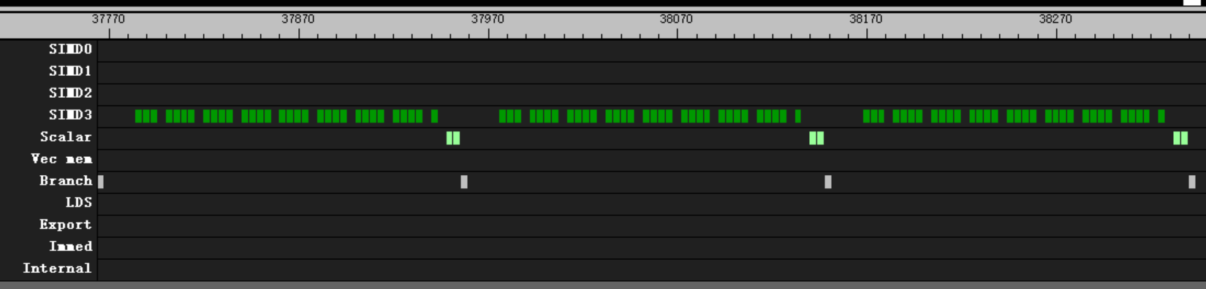
valu
1 wave per CU
60 group
32 valu per loop
16 clk after s_branch
4 clk after every 4 valu
4 clk after all valu
v_mov_b32 v[v_test+ 0], 1.2
v_mov_b32 v[v_test+ 1], 1.2
v_mov_b32 v[v_test+ 2], 1.2
v_mov_b32 v[v_test+ 3], 1.2
v_mov_b32 v[v_test+ 4], 1.2
v_mov_b32 v[v_test+ 5], 1.2
v_mov_b32 v[v_test+ 6], 1.2
v_mov_b32 v[v_test+ 7], 1.2
v_mov_b32 v[v_test+ 8], 1.2
v_mov_b32 v[v_test+ 9], 1.2
v_mov_b32 v[v_test+10], 1.2
v_mov_b32 v[v_test+11], 1.2
v_mov_b32 v[v_test+12], 1.2
v_mov_b32 v[v_test+13], 1.2
v_mov_b32 v[v_test+14], 1.2
v_mov_b32 v[v_test+15], 1.2

Slide 3
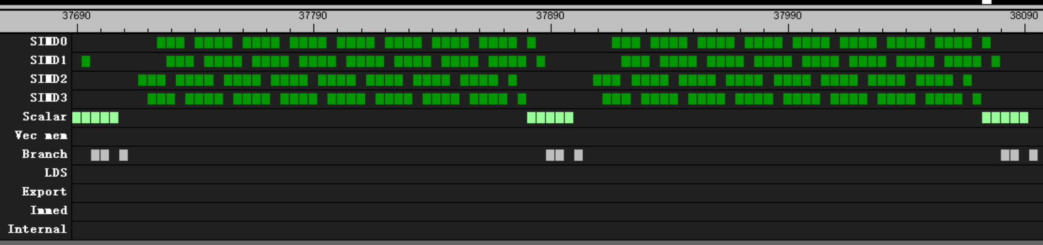
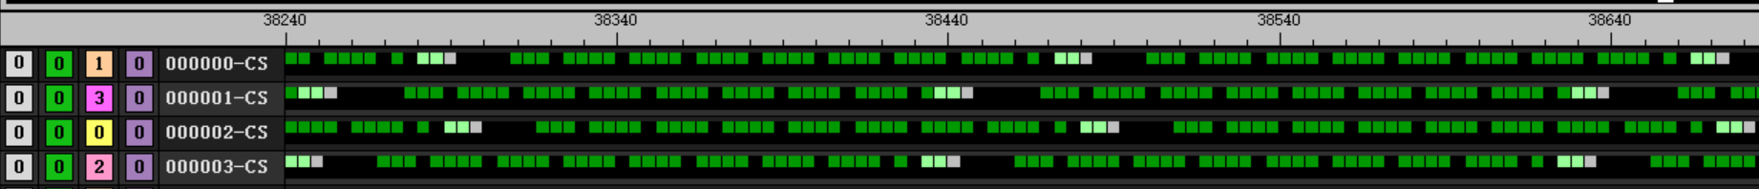
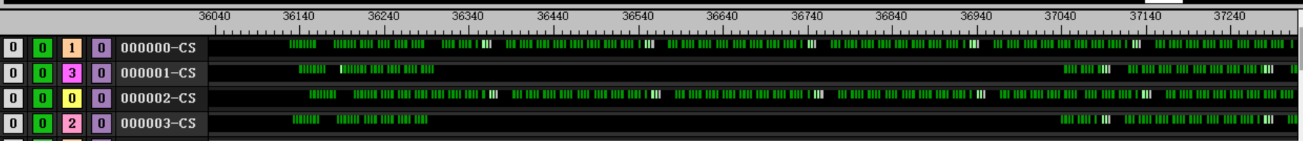
valu
v_mov_b32 v[v_test+ 0], 1.2
v_mov_b32 v[v_test+ 1], 1.2
v_mov_b32 v[v_test+ 2], 1.2
v_mov_b32 v[v_test+ 3], 1.2
v_mov_b32 v[v_test+ 4], 1.2
v_mov_b32 v[v_test+ 5], 1.2
v_mov_b32 v[v_test+ 6], 1.2
v_mov_b32 v[v_test+ 7], 1.2
v_mov_b32 v[v_test+ 8], 1.2
v_mov_b32 v[v_test+ 9], 1.2
v_mov_b32 v[v_test+10], 1.2
v_mov_b32 v[v_test+11], 1.2
v_mov_b32 v[v_test+12], 1.2
v_mov_b32 v[v_test+13], 1.2
v_mov_b32 v[v_test+14], 1.2
v_mov_b32 v[v_test+15], 1.2
4 wave per CU
60 group
32 valu per loop
192 clk per loop
2 wave delay

Slide 4
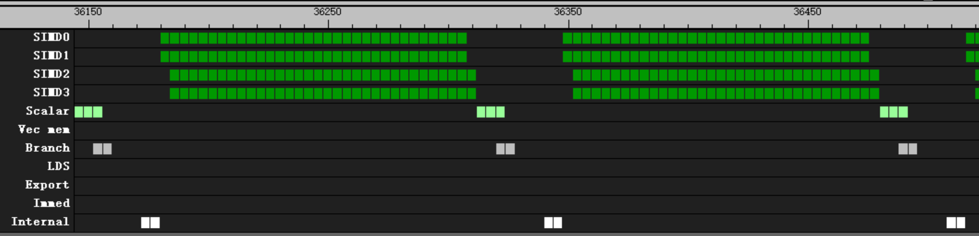
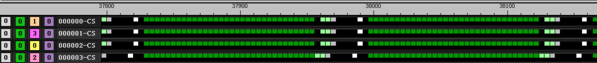
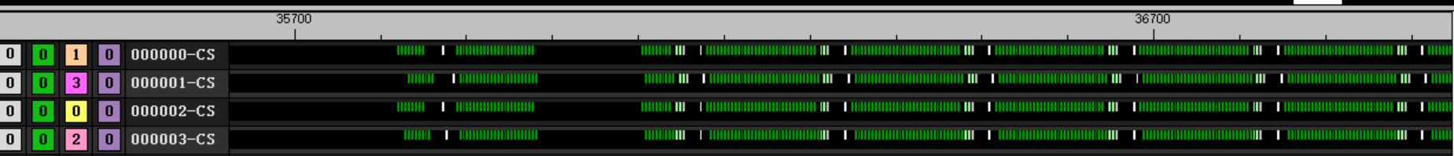
valu
s_barrier
v_mov_b32 v[v_test+ 0], 1.2
v_mov_b32 v[v_test+ 1], 1.2
v_mov_b32 v[v_test+ 2], 1.2
v_mov_b32 v[v_test+ 3], 1.2
v_mov_b32 v[v_test+ 4], 1.2
v_mov_b32 v[v_test+ 5], 1.2
v_mov_b32 v[v_test+ 6], 1.2
v_mov_b32 v[v_test+ 7], 1.2
v_mov_b32 v[v_test+ 8], 1.2
v_mov_b32 v[v_test+ 9], 1.2
v_mov_b32 v[v_test+10], 1.2
v_mov_b32 v[v_test+11], 1.2
v_mov_b32 v[v_test+12], 1.2
v_mov_b32 v[v_test+13], 1.2
v_mov_b32 v[v_test+14], 1.2
v_mov_b32 v[v_test+15], 1.2
4 wave per CU
60 group
32 valu per loop with barrier
168 clk per loop
16 clk after s_branch
4 clk after barrier
4wave start together

Slide 5
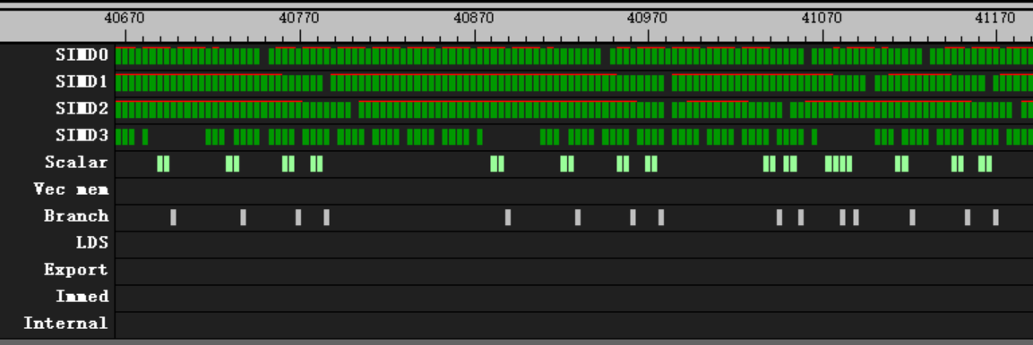
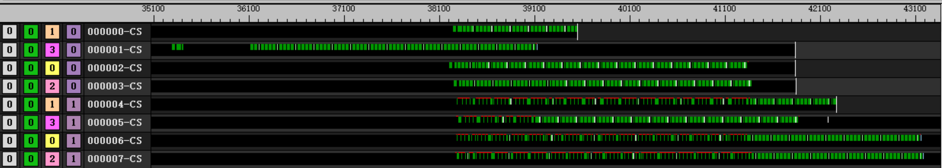
valu
v_mov_b32 v[v_test+ 0], 1.2
v_mov_b32 v[v_test+ 1], 1.2
v_mov_b32 v[v_test+ 2], 1.2
v_mov_b32 v[v_test+ 3], 1.2
v_mov_b32 v[v_test+ 4], 1.2
v_mov_b32 v[v_test+ 5], 1.2
v_mov_b32 v[v_test+ 6], 1.2
v_mov_b32 v[v_test+ 7], 1.2
v_mov_b32 v[v_test+ 8], 1.2
v_mov_b32 v[v_test+ 9], 1.2
v_mov_b32 v[v_test+10], 1.2
v_mov_b32 v[v_test+11], 1.2
v_mov_b32 v[v_test+12], 1.2
v_mov_b32 v[v_test+13], 1.2
v_mov_b32 v[v_test+14], 1.2
v_mov_b32 v[v_test+15], 1.2
8 wave per CU
60 group
32 valu per loop

Slide 6
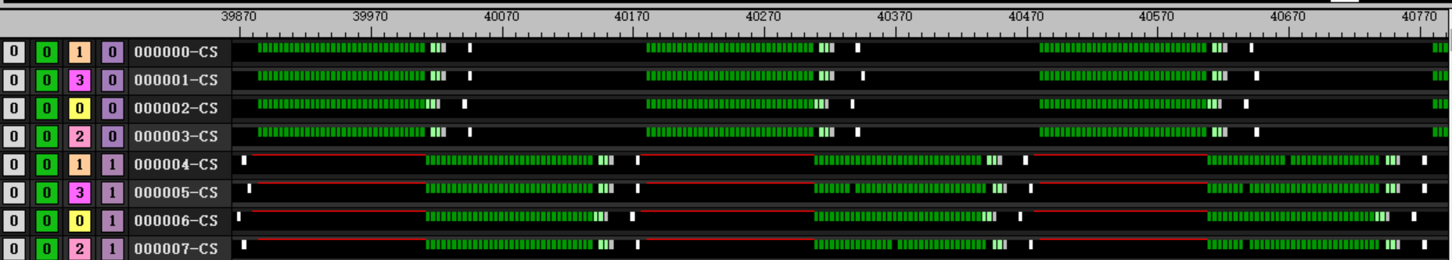
valu
s_barrier
v_mov_b32 v[v_test+ 0], 1.2
v_mov_b32 v[v_test+ 1], 1.2
v_mov_b32 v[v_test+ 2], 1.2
v_mov_b32 v[v_test+ 3], 1.2
v_mov_b32 v[v_test+ 4], 1.2
v_mov_b32 v[v_test+ 5], 1.2
v_mov_b32 v[v_test+ 6], 1.2
v_mov_b32 v[v_test+ 7], 1.2
v_mov_b32 v[v_test+ 8], 1.2
v_mov_b32 v[v_test+ 9], 1.2
v_mov_b32 v[v_test+10], 1.2
v_mov_b32 v[v_test+11], 1.2
v_mov_b32 v[v_test+12], 1.2
v_mov_b32 v[v_test+13], 1.2
v_mov_b32 v[v_test+14], 1.2
v_mov_b32 v[v_test+15], 1.2
8 wave per CU
60 group
32 valu per loop with barrier
300 clk per loop
16 clk after s_branch
4 clk after barrier
4wave start together

Slide 7
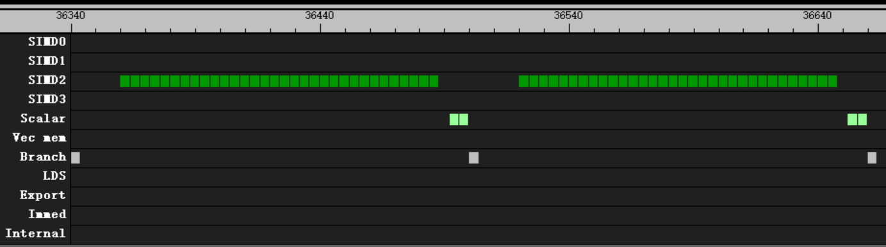
valu
1 wave per CU
60 group
32 valu per loop
16 clk after s_branch
4 clk after all valu
v_add_f32 v[v_test+ 0], v[v_test+ 0], v[v_test+ 0]
v_add_f32 v[v_test+ 1], v[v_test+ 1], v[v_test+ 1]
v_add_f32 v[v_test+ 2], v[v_test+ 2], v[v_test+ 2]
v_add_f32 v[v_test+ 3], v[v_test+ 3], v[v_test+ 3]
v_add_f32 v[v_test+ 4], v[v_test+ 4], v[v_test+ 4]
v_add_f32 v[v_test+ 5], v[v_test+ 5], v[v_test+ 5]
v_add_f32 v[v_test+ 6], v[v_test+ 6], v[v_test+ 6]
v_add_f32 v[v_test+ 7], v[v_test+ 7], v[v_test+ 7]
v_add_f32 v[v_test+ 8], v[v_test+ 8], v[v_test+ 8]
v_add_f32 v[v_test+ 9], v[v_test+ 9], v[v_test+ 9]
v_add_f32 v[v_test+10], v[v_test+10], v[v_test+10]
v_add_f32 v[v_test+11], v[v_test+11], v[v_test+11]
v_add_f32 v[v_test+12], v[v_test+12], v[v_test+12]
v_add_f32 v[v_test+13], v[v_test+13], v[v_test+13]
v_add_f32 v[v_test+14], v[v_test+14], v[v_test+14]
v_add_f32 v[v_test+15], v[v_test+15], v[v_test+15]

Slide 8
valu
1 wave per CU
60 group
32 valu per loop
16 clk after s_branch
4 clk after all valu
v_add_f32 v[v_test+ 0], v[v_test+ 0], v[v_test+ 0]
v_add_f32 v[v_test+ 0], v[v_test+ 0], v[v_test+ 1]
v_add_f32 v[v_test+ 0], v[v_test+ 0], v[v_test+ 2]
v_add_f32 v[v_test+ 0], v[v_test+ 0], v[v_test+ 3]
v_add_f32 v[v_test+ 0], v[v_test+ 0], v[v_test+ 4]
v_add_f32 v[v_test+ 0], v[v_test+ 0], v[v_test+ 5]
v_add_f32 v[v_test+ 0], v[v_test+ 0], v[v_test+ 6]
v_add_f32 v[v_test+ 0], v[v_test+ 0], v[v_test+ 7]
v_add_f32 v[v_test+ 0], v[v_test+ 0], v[v_test+ 8]
v_add_f32 v[v_test+ 0], v[v_test+ 0], v[v_test+ 9]
v_add_f32 v[v_test+ 0], v[v_test+ 0], v[v_test+10]
v_add_f32 v[v_test+ 0], v[v_test+ 0], v[v_test+11]
v_add_f32 v[v_test+ 0], v[v_test+ 0], v[v_test+12]
v_add_f32 v[v_test+ 0], v[v_test+ 0], v[v_test+13]
v_add_f32 v[v_test+ 0], v[v_test+ 0], v[v_test+14]
v_add_f32 v[v_test+ 0], v[v_test+ 0], v[v_test+15]

Slide 9
valu
1 wave per CU
60 group
32 valu per loop
16 clk after s_branch
4 clk after all valu
v_add_f32 v[v_test+ 0], v[v_test+15], v[v_test+14]
v_add_f32 v[v_test+ 1], v[v_test+ 0], v[v_test+15]
v_add_f32 v[v_test+ 2], v[v_test+ 1], v[v_test+ 0]
v_add_f32 v[v_test+ 3], v[v_test+ 2], v[v_test+ 1]
v_add_f32 v[v_test+ 4], v[v_test+ 3], v[v_test+ 2]
v_add_f32 v[v_test+ 5], v[v_test+ 4], v[v_test+ 3]
v_add_f32 v[v_test+ 6], v[v_test+ 5], v[v_test+ 4]
v_add_f32 v[v_test+ 7], v[v_test+ 6], v[v_test+ 5]
v_add_f32 v[v_test+ 8], v[v_test+ 7], v[v_test+ 6]
v_add_f32 v[v_test+ 9], v[v_test+ 8], v[v_test+ 7]
v_add_f32 v[v_test+10], v[v_test+ 9], v[v_test+ 8]
v_add_f32 v[v_test+11], v[v_test+10], v[v_test+ 9]
v_add_f32 v[v_test+12], v[v_test+11], v[v_test+10]
v_add_f32 v[v_test+13], v[v_test+12], v[v_test+11]
v_add_f32 v[v_test+14], v[v_test+13], v[v_test+12]
v_add_f32 v[v_test+15], v[v_test+14], v[v_test+13]

Slide 10
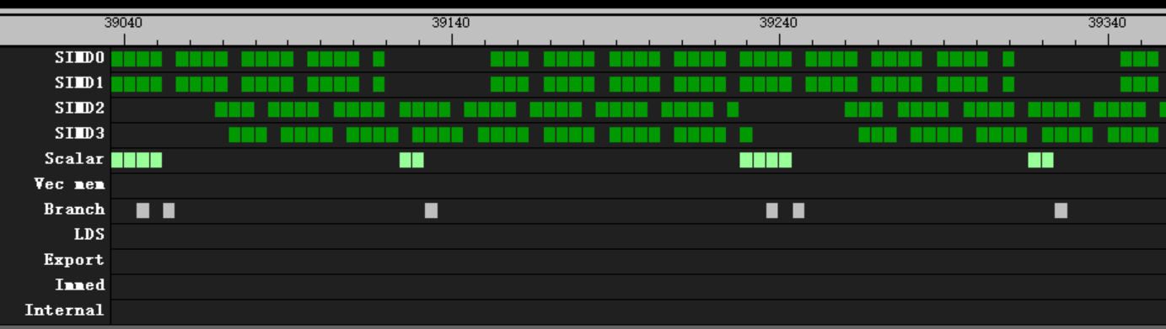
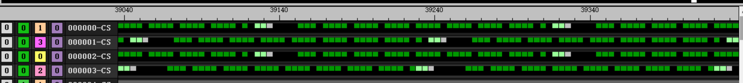
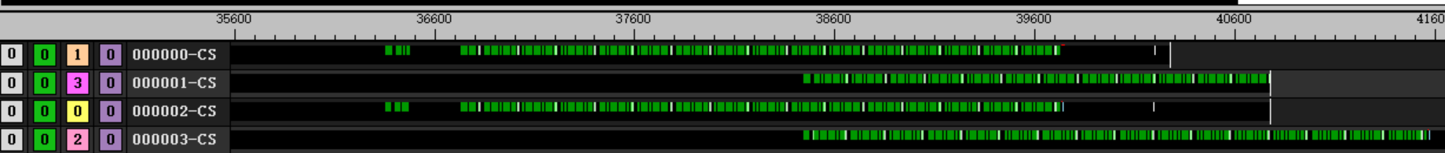
valu
v_add3_u32 v[v_test+ 0], v[v_test+15], v[v_test+14], v[v_test+ 0]
v_add3_u32 v[v_test+ 1], v[v_test+ 0], v[v_test+15], v[v_test+ 1]
v_add3_u32 v[v_test+ 2], v[v_test+ 1], v[v_test+ 0], v[v_test+ 2]
v_add3_u32 v[v_test+ 3], v[v_test+ 2], v[v_test+ 1], v[v_test+ 3]
v_add3_u32 v[v_test+ 4], v[v_test+ 3], v[v_test+ 2], v[v_test+ 4]
v_add3_u32 v[v_test+ 5], v[v_test+ 4], v[v_test+ 3], v[v_test+ 5]
v_add3_u32 v[v_test+ 6], v[v_test+ 5], v[v_test+ 4], v[v_test+ 6]
v_add3_u32 v[v_test+ 7], v[v_test+ 6], v[v_test+ 5], v[v_test+ 7]
v_add3_u32 v[v_test+ 8], v[v_test+ 7], v[v_test+ 6], v[v_test+ 8]
v_add3_u32 v[v_test+ 9], v[v_test+ 8], v[v_test+ 7], v[v_test+ 9]
v_add3_u32 v[v_test+10], v[v_test+ 9], v[v_test+ 8], v[v_test+10]
v_add3_u32 v[v_test+11], v[v_test+10], v[v_test+ 9], v[v_test+11]
v_add3_u32 v[v_test+12], v[v_test+11], v[v_test+10], v[v_test+12]
v_add3_u32 v[v_test+13], v[v_test+12], v[v_test+11], v[v_test+13]
v_add3_u32 v[v_test+14], v[v_test+13], v[v_test+12], v[v_test+14]
v_add3_u32 v[v_test+15], v[v_test+14], v[v_test+13], v[v_test+15]
4 wave per CU
60 group
32 valu per loop
192 clk per loop

Slide 11
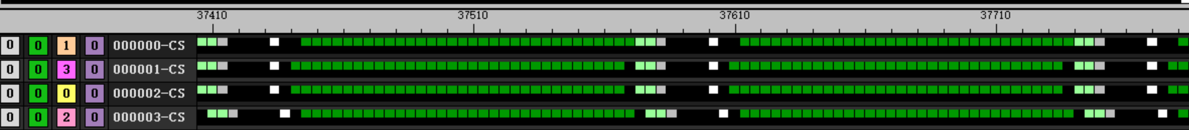
valu
s_barrier
v_add3_u32 v[v_test+ 0], v[v_test+15], v[v_test+14], v[v_test+ 0]
v_add3_u32 v[v_test+ 1], v[v_test+ 0], v[v_test+15], v[v_test+ 1]
v_add3_u32 v[v_test+ 2], v[v_test+ 1], v[v_test+ 0], v[v_test+ 2]
v_add3_u32 v[v_test+ 3], v[v_test+ 2], v[v_test+ 1], v[v_test+ 3]
v_add3_u32 v[v_test+ 4], v[v_test+ 3], v[v_test+ 2], v[v_test+ 4]
v_add3_u32 v[v_test+ 5], v[v_test+ 4], v[v_test+ 3], v[v_test+ 5]
v_add3_u32 v[v_test+ 6], v[v_test+ 5], v[v_test+ 4], v[v_test+ 6]
v_add3_u32 v[v_test+ 7], v[v_test+ 6], v[v_test+ 5], v[v_test+ 7]
v_add3_u32 v[v_test+ 8], v[v_test+ 7], v[v_test+ 6], v[v_test+ 8]
v_add3_u32 v[v_test+ 9], v[v_test+ 8], v[v_test+ 7], v[v_test+ 9]
v_add3_u32 v[v_test+10], v[v_test+ 9], v[v_test+ 8], v[v_test+10]
v_add3_u32 v[v_test+11], v[v_test+10], v[v_test+ 9], v[v_test+11]
v_add3_u32 v[v_test+12], v[v_test+11], v[v_test+10], v[v_test+12]
v_add3_u32 v[v_test+13], v[v_test+12], v[v_test+11], v[v_test+13]
v_add3_u32 v[v_test+14], v[v_test+13], v[v_test+12], v[v_test+14]
v_add3_u32 v[v_test+15], v[v_test+14], v[v_test+13], v[v_test+15]
4 wave per CU
60 group
32 valu per loop with barrier
168 clk per loop

Slide 12
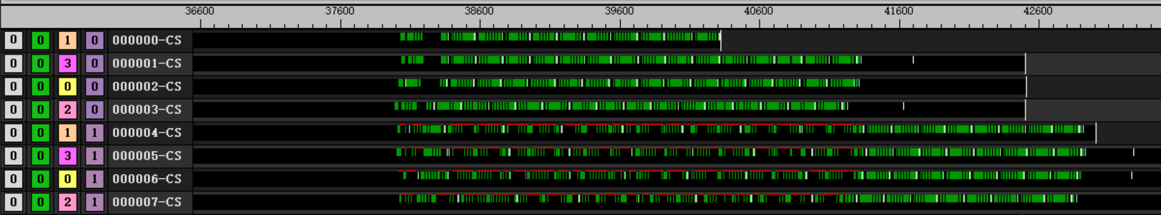
valu
v_add3_u32 v[v_test+ 0], v[v_test+15], v[v_test+14], v[v_test+ 0]
v_add3_u32 v[v_test+ 1], v[v_test+ 0], v[v_test+15], v[v_test+ 1]
v_add3_u32 v[v_test+ 2], v[v_test+ 1], v[v_test+ 0], v[v_test+ 2]
v_add3_u32 v[v_test+ 3], v[v_test+ 2], v[v_test+ 1], v[v_test+ 3]
v_add3_u32 v[v_test+ 4], v[v_test+ 3], v[v_test+ 2], v[v_test+ 4]
v_add3_u32 v[v_test+ 5], v[v_test+ 4], v[v_test+ 3], v[v_test+ 5]
v_add3_u32 v[v_test+ 6], v[v_test+ 5], v[v_test+ 4], v[v_test+ 6]
v_add3_u32 v[v_test+ 7], v[v_test+ 6], v[v_test+ 5], v[v_test+ 7]
v_add3_u32 v[v_test+ 8], v[v_test+ 7], v[v_test+ 6], v[v_test+ 8]
v_add3_u32 v[v_test+ 9], v[v_test+ 8], v[v_test+ 7], v[v_test+ 9]
v_add3_u32 v[v_test+10], v[v_test+ 9], v[v_test+ 8], v[v_test+10]
v_add3_u32 v[v_test+11], v[v_test+10], v[v_test+ 9], v[v_test+11]
v_add3_u32 v[v_test+12], v[v_test+11], v[v_test+10], v[v_test+12]
v_add3_u32 v[v_test+13], v[v_test+12], v[v_test+11], v[v_test+13]
v_add3_u32 v[v_test+14], v[v_test+13], v[v_test+12], v[v_test+14]
v_add3_u32 v[v_test+15], v[v_test+14], v[v_test+13], v[v_test+15]
8 wave per CU
60 group
32 valu per loop

Slide 13
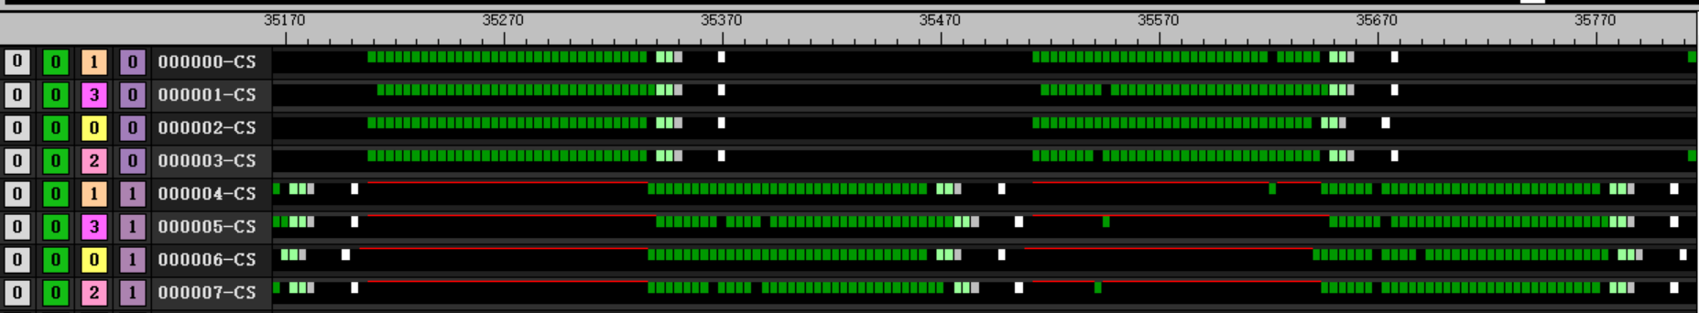
valu
s_barrier
v_add3_u32 v[v_test+ 0], v[v_test+15], v[v_test+14], v[v_test+ 0]
v_add3_u32 v[v_test+ 1], v[v_test+ 0], v[v_test+15], v[v_test+ 1]
v_add3_u32 v[v_test+ 2], v[v_test+ 1], v[v_test+ 0], v[v_test+ 2]
v_add3_u32 v[v_test+ 3], v[v_test+ 2], v[v_test+ 1], v[v_test+ 3]
v_add3_u32 v[v_test+ 4], v[v_test+ 3], v[v_test+ 2], v[v_test+ 4]
v_add3_u32 v[v_test+ 5], v[v_test+ 4], v[v_test+ 3], v[v_test+ 5]
v_add3_u32 v[v_test+ 6], v[v_test+ 5], v[v_test+ 4], v[v_test+ 6]
v_add3_u32 v[v_test+ 7], v[v_test+ 6], v[v_test+ 5], v[v_test+ 7]
v_add3_u32 v[v_test+ 8], v[v_test+ 7], v[v_test+ 6], v[v_test+ 8]
v_add3_u32 v[v_test+ 9], v[v_test+ 8], v[v_test+ 7], v[v_test+ 9]
v_add3_u32 v[v_test+10], v[v_test+ 9], v[v_test+ 8], v[v_test+10]
v_add3_u32 v[v_test+11], v[v_test+10], v[v_test+ 9], v[v_test+11]
v_add3_u32 v[v_test+12], v[v_test+11], v[v_test+10], v[v_test+12]
v_add3_u32 v[v_test+13], v[v_test+12], v[v_test+11], v[v_test+13]
v_add3_u32 v[v_test+14], v[v_test+13], v[v_test+12], v[v_test+14]
v_add3_u32 v[v_test+15], v[v_test+14], v[v_test+13], v[v_test+15]
8 wave per CU
60 group
32 valu per loop with barrier
304 clk per loop

Slide 14
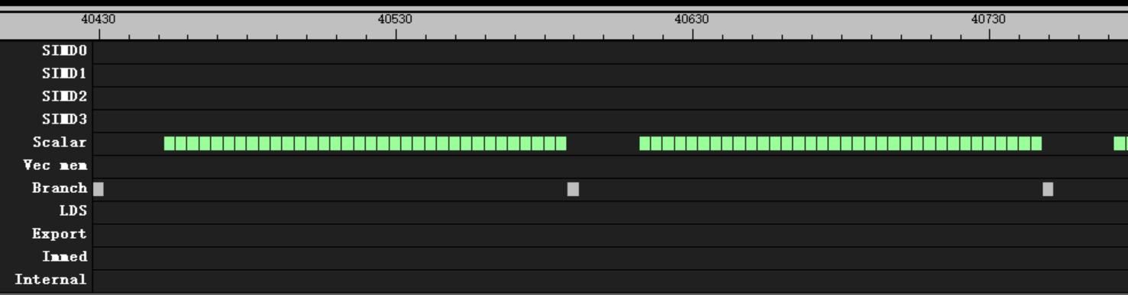
salu
1 wave per CU
60 group
32 salu per loop
20 clk after s_branch
s_add_u32 s[s_test+ 0], s[s_test+ 0], s[s_test+ 0]
s_add_u32 s[s_test+ 1], s[s_test+ 1], s[s_test+ 1]
s_add_u32 s[s_test+ 2], s[s_test+ 2], s[s_test+ 2]
s_add_u32 s[s_test+ 3], s[s_test+ 3], s[s_test+ 3]
s_add_u32 s[s_test+ 4], s[s_test+ 4], s[s_test+ 4]
s_add_u32 s[s_test+ 5], s[s_test+ 5], s[s_test+ 5]
s_add_u32 s[s_test+ 6], s[s_test+ 6], s[s_test+ 6]
s_add_u32 s[s_test+ 7], s[s_test+ 7], s[s_test+ 7]
s_add_u32 s[s_test+ 8], s[s_test+ 8], s[s_test+ 8]
s_add_u32 s[s_test+ 9], s[s_test+ 9], s[s_test+ 9]
s_add_u32 s[s_test+10], s[s_test+10], s[s_test+10]
s_add_u32 s[s_test+11], s[s_test+11], s[s_test+11]
s_add_u32 s[s_test+12], s[s_test+12], s[s_test+12]
s_add_u32 s[s_test+13], s[s_test+13], s[s_test+13]
s_add_u32 s[s_test+14], s[s_test+14], s[s_test+14]
s_add_u32 s[s_test+15], s[s_test+15], s[s_test+15]

Slide 15
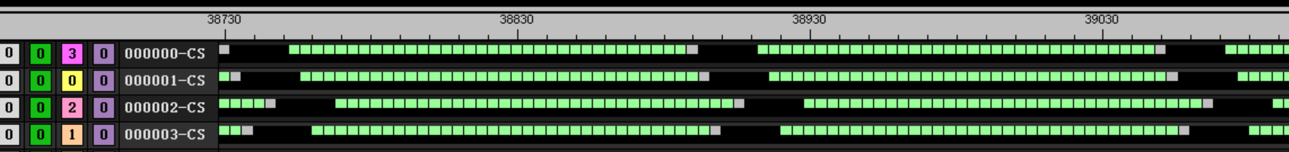
salu
s_add_u32 s[s_test+ 0], s[s_test+ 0], s[s_test+ 0]
s_add_u32 s[s_test+ 1], s[s_test+ 1], s[s_test+ 1]
s_add_u32 s[s_test+ 2], s[s_test+ 2], s[s_test+ 2]
s_add_u32 s[s_test+ 3], s[s_test+ 3], s[s_test+ 3]
s_add_u32 s[s_test+ 4], s[s_test+ 4], s[s_test+ 4]
s_add_u32 s[s_test+ 5], s[s_test+ 5], s[s_test+ 5]
s_add_u32 s[s_test+ 6], s[s_test+ 6], s[s_test+ 6]
s_add_u32 s[s_test+ 7], s[s_test+ 7], s[s_test+ 7]
s_add_u32 s[s_test+ 8], s[s_test+ 8], s[s_test+ 8]
s_add_u32 s[s_test+ 9], s[s_test+ 9], s[s_test+ 9]
s_add_u32 s[s_test+10], s[s_test+10], s[s_test+10]
s_add_u32 s[s_test+11], s[s_test+11], s[s_test+11]
s_add_u32 s[s_test+12], s[s_test+12], s[s_test+12]
s_add_u32 s[s_test+13], s[s_test+13], s[s_test+13]
s_add_u32 s[s_test+14], s[s_test+14], s[s_test+14]
s_add_u32 s[s_test+15], s[s_test+15], s[s_test+15]
4 wave per CU
60 group
32 salu per loop
20 clk after s_branch

Slide 16
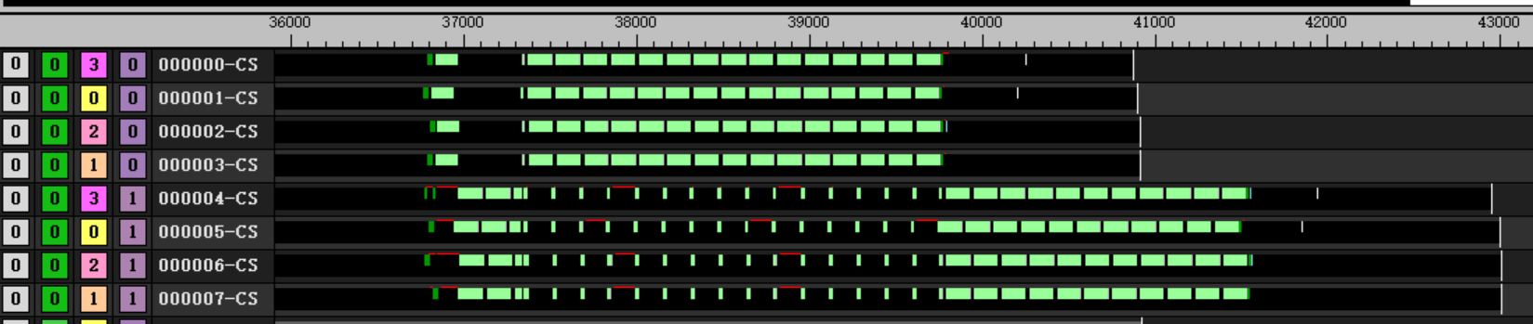
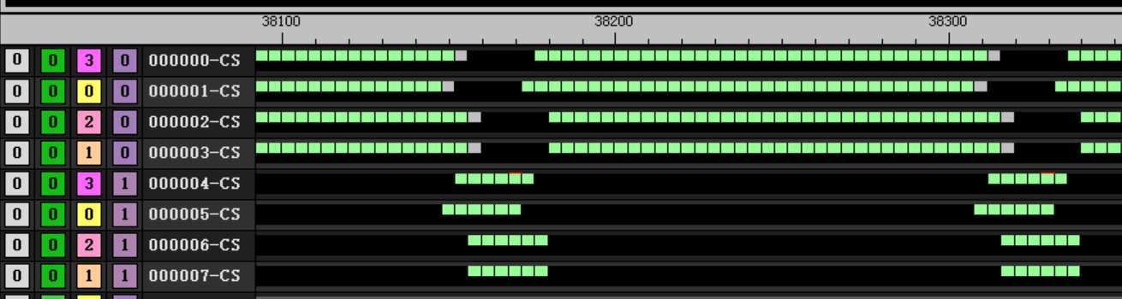
salu
s_add_u32 s[s_test+ 0], s[s_test+ 0], s[s_test+ 0]
s_add_u32 s[s_test+ 1], s[s_test+ 1], s[s_test+ 1]
s_add_u32 s[s_test+ 2], s[s_test+ 2], s[s_test+ 2]
s_add_u32 s[s_test+ 3], s[s_test+ 3], s[s_test+ 3]
s_add_u32 s[s_test+ 4], s[s_test+ 4], s[s_test+ 4]
s_add_u32 s[s_test+ 5], s[s_test+ 5], s[s_test+ 5]
s_add_u32 s[s_test+ 6], s[s_test+ 6], s[s_test+ 6]
s_add_u32 s[s_test+ 7], s[s_test+ 7], s[s_test+ 7]
s_add_u32 s[s_test+ 8], s[s_test+ 8], s[s_test+ 8]
s_add_u32 s[s_test+ 9], s[s_test+ 9], s[s_test+ 9]
s_add_u32 s[s_test+10], s[s_test+10], s[s_test+10]
s_add_u32 s[s_test+11], s[s_test+11], s[s_test+11]
s_add_u32 s[s_test+12], s[s_test+12], s[s_test+12]
s_add_u32 s[s_test+13], s[s_test+13], s[s_test+13]
s_add_u32 s[s_test+14], s[s_test+14], s[s_test+14]
s_add_u32 s[s_test+15], s[s_test+15], s[s_test+15]
8 wave per CU
60 group
32 salu per loop
20 clk after s_branch
Between branch will switch to other wave
Total 40916 clk for idle wave
Total 43008 clk for block wave

Slide 17
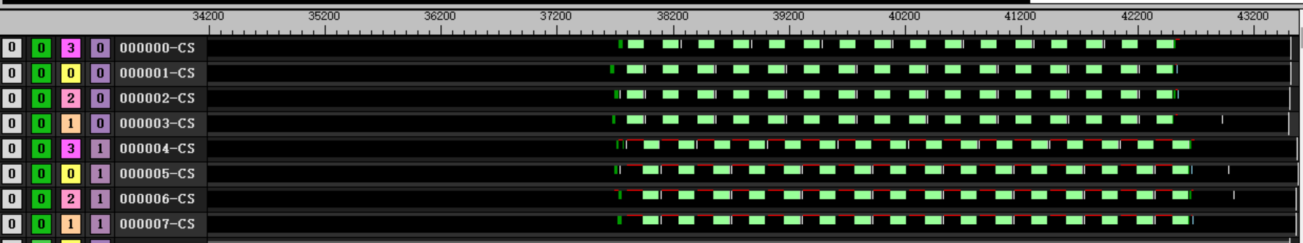
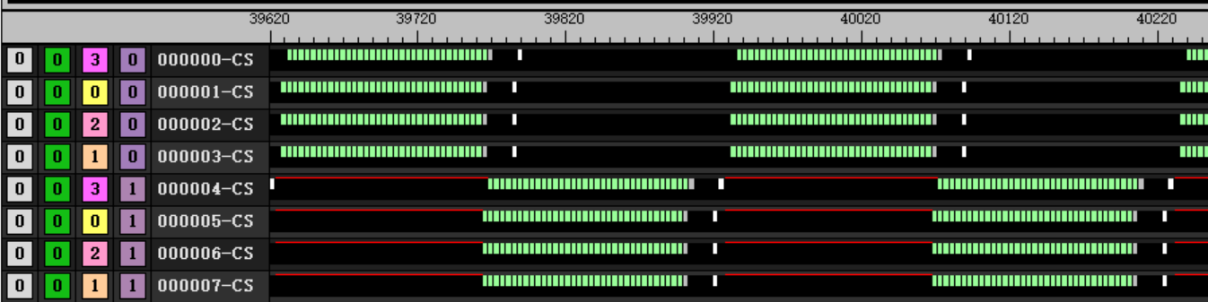
salu
s_add_u32 s[s_test+ 0], s[s_test+ 0], s[s_test+ 0]
s_add_u32 s[s_test+ 1], s[s_test+ 1], s[s_test+ 1]
s_add_u32 s[s_test+ 2], s[s_test+ 2], s[s_test+ 2]
s_add_u32 s[s_test+ 3], s[s_test+ 3], s[s_test+ 3]
s_add_u32 s[s_test+ 4], s[s_test+ 4], s[s_test+ 4]
s_add_u32 s[s_test+ 5], s[s_test+ 5], s[s_test+ 5]
s_add_u32 s[s_test+ 6], s[s_test+ 6], s[s_test+ 6]
s_add_u32 s[s_test+ 7], s[s_test+ 7], s[s_test+ 7]
s_add_u32 s[s_test+ 8], s[s_test+ 8], s[s_test+ 8]
s_add_u32 s[s_test+ 9], s[s_test+ 9], s[s_test+ 9]
s_add_u32 s[s_test+10], s[s_test+10], s[s_test+10]
s_add_u32 s[s_test+11], s[s_test+11], s[s_test+11]
s_add_u32 s[s_test+12], s[s_test+12], s[s_test+12]
s_add_u32 s[s_test+13], s[s_test+13], s[s_test+13]
s_add_u32 s[s_test+14], s[s_test+14], s[s_test+14]
s_add_u32 s[s_test+15], s[s_test+15], s[s_test+15]
8 wave per CU
60 group
32 salu per loop with barrier
after branch will switch to block wave immediately
After branch switch to idle wave takes 20 clk
Total 43520 clk

Slide 18
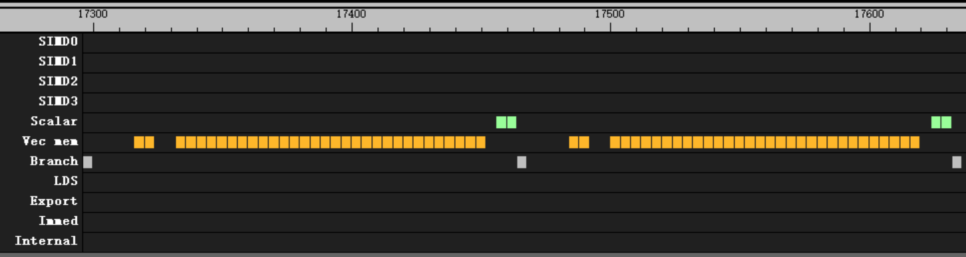
Flat load
flat_load_dword v[v_test+ 0], v[v_addr_a:v_addr_a + 1] offset:4* 0
flat_load_dword v[v_test+ 1], v[v_addr_a:v_addr_a + 1] offset:4* 1
flat_load_dword v[v_test+ 2], v[v_addr_a:v_addr_a + 1] offset:4* 2
flat_load_dword v[v_test+ 3], v[v_addr_a:v_addr_a + 1] offset:4* 3
flat_load_dword v[v_test+ 4], v[v_addr_a:v_addr_a + 1] offset:4* 4
flat_load_dword v[v_test+ 5], v[v_addr_a:v_addr_a + 1] offset:4* 5
flat_load_dword v[v_test+ 6], v[v_addr_a:v_addr_a + 1] offset:4* 6
flat_load_dword v[v_test+ 7], v[v_addr_a:v_addr_a + 1] offset:4* 7
flat_load_dword v[v_test+ 8], v[v_addr_a:v_addr_a + 1] offset:4* 8
flat_load_dword v[v_test+ 9], v[v_addr_a:v_addr_a + 1] offset:4* 9
flat_load_dword v[v_test+10], v[v_addr_a:v_addr_a + 1] offset:4*10
flat_load_dword v[v_test+11], v[v_addr_a:v_addr_a + 1] offset:4*11
flat_load_dword v[v_test+12], v[v_addr_a:v_addr_a + 1] offset:4*12
flat_load_dword v[v_test+13], v[v_addr_a:v_addr_a + 1] offset:4*13
flat_load_dword v[v_test+14], v[v_addr_a:v_addr_a + 1] offset:4*14
flat_load_dword v[v_test+15], v[v_addr_a:v_addr_a + 1] offset:4*15
kernel
4 wave per CU
60 group
32 flat per loop
Behavior
16 clk after s_branch
8 clk after first 2 flat
4 clk after all flat

Slide 19
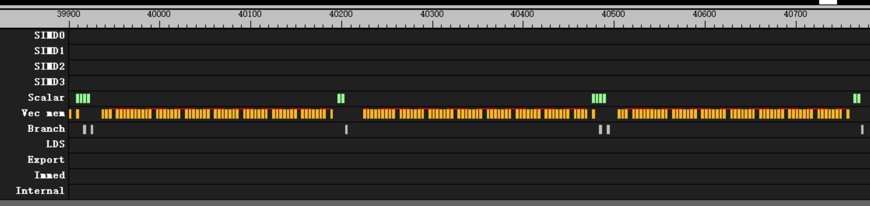
Flat load
flat_load_dword v[v_test+ 0], v[v_addr_a:v_addr_a + 1] offset:4* 0
flat_load_dword v[v_test+ 1], v[v_addr_a:v_addr_a + 1] offset:4* 1
flat_load_dword v[v_test+ 2], v[v_addr_a:v_addr_a + 1] offset:4* 2
flat_load_dword v[v_test+ 3], v[v_addr_a:v_addr_a + 1] offset:4* 3
flat_load_dword v[v_test+ 4], v[v_addr_a:v_addr_a + 1] offset:4* 4
flat_load_dword v[v_test+ 5], v[v_addr_a:v_addr_a + 1] offset:4* 5
flat_load_dword v[v_test+ 6], v[v_addr_a:v_addr_a + 1] offset:4* 6
flat_load_dword v[v_test+ 7], v[v_addr_a:v_addr_a + 1] offset:4* 7
flat_load_dword v[v_test+ 8], v[v_addr_a:v_addr_a + 1] offset:4* 8
flat_load_dword v[v_test+ 9], v[v_addr_a:v_addr_a + 1] offset:4* 9
flat_load_dword v[v_test+10], v[v_addr_a:v_addr_a + 1] offset:4*10
flat_load_dword v[v_test+11], v[v_addr_a:v_addr_a + 1] offset:4*11
flat_load_dword v[v_test+12], v[v_addr_a:v_addr_a + 1] offset:4*12
flat_load_dword v[v_test+13], v[v_addr_a:v_addr_a + 1] offset:4*13
flat_load_dword v[v_test+14], v[v_addr_a:v_addr_a + 1] offset:4*14
flat_load_dword v[v_test+15], v[v_addr_a:v_addr_a + 1] offset:4*15
kernel
2 wave per CU
60 group
32 flat per loop
Behavior
Switch simd every 8 flat

Slide 20
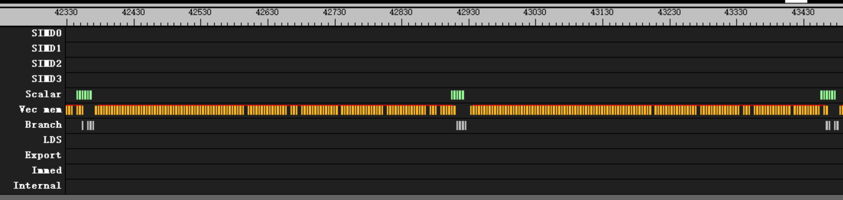
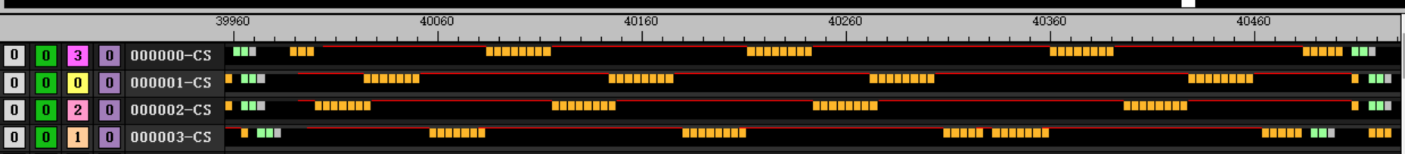
Flat load
flat_load_dword v[v_test+ 0], v[v_addr_a:v_addr_a + 1] offset:4* 0
flat_load_dword v[v_test+ 1], v[v_addr_a:v_addr_a + 1] offset:4* 1
flat_load_dword v[v_test+ 2], v[v_addr_a:v_addr_a + 1] offset:4* 2
flat_load_dword v[v_test+ 3], v[v_addr_a:v_addr_a + 1] offset:4* 3
flat_load_dword v[v_test+ 4], v[v_addr_a:v_addr_a + 1] offset:4* 4
flat_load_dword v[v_test+ 5], v[v_addr_a:v_addr_a + 1] offset:4* 5
flat_load_dword v[v_test+ 6], v[v_addr_a:v_addr_a + 1] offset:4* 6
flat_load_dword v[v_test+ 7], v[v_addr_a:v_addr_a + 1] offset:4* 7
flat_load_dword v[v_test+ 8], v[v_addr_a:v_addr_a + 1] offset:4* 8
flat_load_dword v[v_test+ 9], v[v_addr_a:v_addr_a + 1] offset:4* 9
flat_load_dword v[v_test+10], v[v_addr_a:v_addr_a + 1] offset:4*10
flat_load_dword v[v_test+11], v[v_addr_a:v_addr_a + 1] offset:4*11
flat_load_dword v[v_test+12], v[v_addr_a:v_addr_a + 1] offset:4*12
flat_load_dword v[v_test+13], v[v_addr_a:v_addr_a + 1] offset:4*13
flat_load_dword v[v_test+14], v[v_addr_a:v_addr_a + 1] offset:4*14
flat_load_dword v[v_test+15], v[v_addr_a:v_addr_a + 1] offset:4*15
kernel
4 wave per CU
60 group
32 flat per loop
Behavior
Switch simd every 8 flat

Slide 21
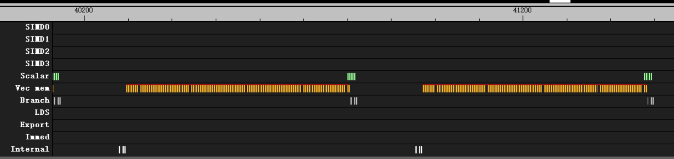
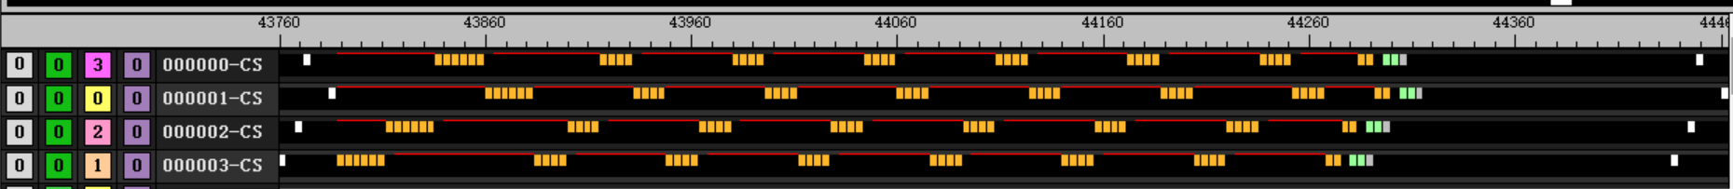
Flat load
kernel
4 wave per CU
60 group
32 flat per loop with barrier
Behavior
Switch simd every 4 flat
144 clk after branch
flat_load_dword v[v_test+ 0], v[v_addr_a:v_addr_a + 1] offset:4* 0
flat_load_dword v[v_test+ 1], v[v_addr_a:v_addr_a + 1] offset:4* 1
flat_load_dword v[v_test+ 2], v[v_addr_a:v_addr_a + 1] offset:4* 2
flat_load_dword v[v_test+ 3], v[v_addr_a:v_addr_a + 1] offset:4* 3
flat_load_dword v[v_test+ 4], v[v_addr_a:v_addr_a + 1] offset:4* 4
flat_load_dword v[v_test+ 5], v[v_addr_a:v_addr_a + 1] offset:4* 5
flat_load_dword v[v_test+ 6], v[v_addr_a:v_addr_a + 1] offset:4* 6
flat_load_dword v[v_test+ 7], v[v_addr_a:v_addr_a + 1] offset:4* 7
flat_load_dword v[v_test+ 8], v[v_addr_a:v_addr_a + 1] offset:4* 8
flat_load_dword v[v_test+ 9], v[v_addr_a:v_addr_a + 1] offset:4* 9
flat_load_dword v[v_test+10], v[v_addr_a:v_addr_a + 1] offset:4*10
flat_load_dword v[v_test+11], v[v_addr_a:v_addr_a + 1] offset:4*11
flat_load_dword v[v_test+12], v[v_addr_a:v_addr_a + 1] offset:4*12
flat_load_dword v[v_test+13], v[v_addr_a:v_addr_a + 1] offset:4*13
flat_load_dword v[v_test+14], v[v_addr_a:v_addr_a + 1] offset:4*14
flat_load_dword v[v_test+15], v[v_addr_a:v_addr_a + 1] offset:4*15

Slide 22
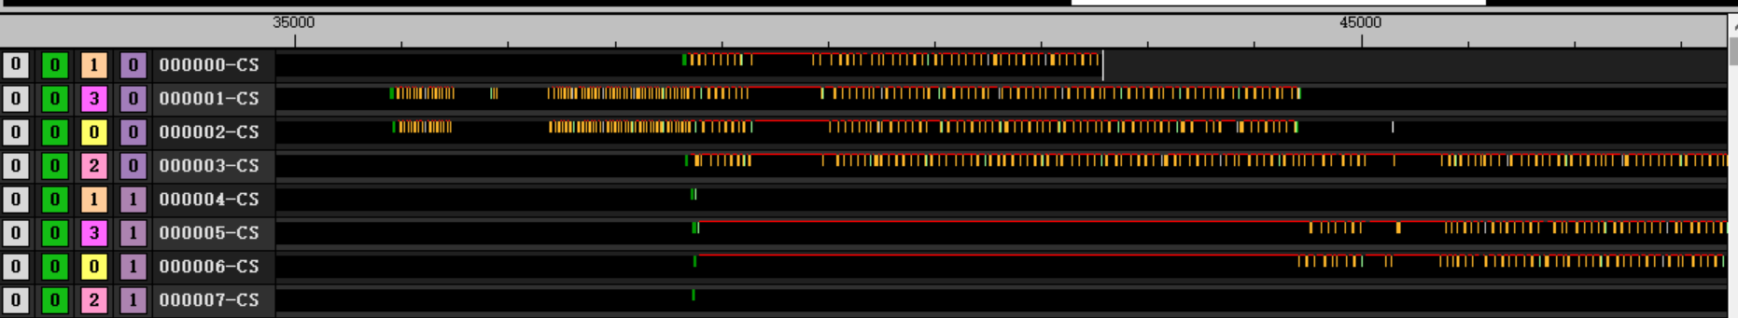
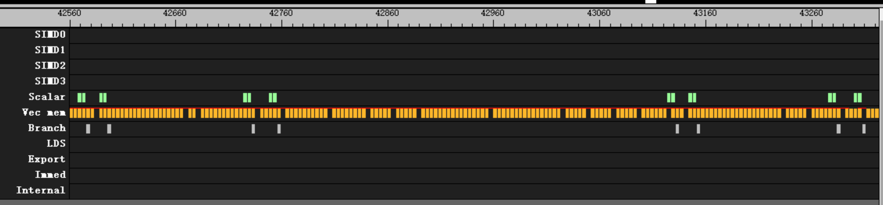
Flat load
flat_load_dword v[v_test+ 0], v[v_addr_a:v_addr_a + 1] offset:4* 0
flat_load_dword v[v_test+ 1], v[v_addr_a:v_addr_a + 1] offset:4* 1
flat_load_dword v[v_test+ 2], v[v_addr_a:v_addr_a + 1] offset:4* 2
flat_load_dword v[v_test+ 3], v[v_addr_a:v_addr_a + 1] offset:4* 3
flat_load_dword v[v_test+ 4], v[v_addr_a:v_addr_a + 1] offset:4* 4
flat_load_dword v[v_test+ 5], v[v_addr_a:v_addr_a + 1] offset:4* 5
flat_load_dword v[v_test+ 6], v[v_addr_a:v_addr_a + 1] offset:4* 6
flat_load_dword v[v_test+ 7], v[v_addr_a:v_addr_a + 1] offset:4* 7
flat_load_dword v[v_test+ 8], v[v_addr_a:v_addr_a + 1] offset:4* 8
flat_load_dword v[v_test+ 9], v[v_addr_a:v_addr_a + 1] offset:4* 9
flat_load_dword v[v_test+10], v[v_addr_a:v_addr_a + 1] offset:4*10
flat_load_dword v[v_test+11], v[v_addr_a:v_addr_a + 1] offset:4*11
flat_load_dword v[v_test+12], v[v_addr_a:v_addr_a + 1] offset:4*12
flat_load_dword v[v_test+13], v[v_addr_a:v_addr_a + 1] offset:4*13
flat_load_dword v[v_test+14], v[v_addr_a:v_addr_a + 1] offset:4*14
flat_load_dword v[v_test+15], v[v_addr_a:v_addr_a + 1] offset:4*15
kernel
8 wave per CU
60 group
32 flat per loop
Behavior
46864 clk for non-block wave
55400 clk for block wave
Switch to block wave only when first wave is doing branch and salu

Slide 23
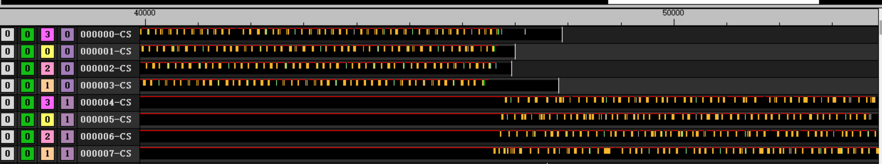
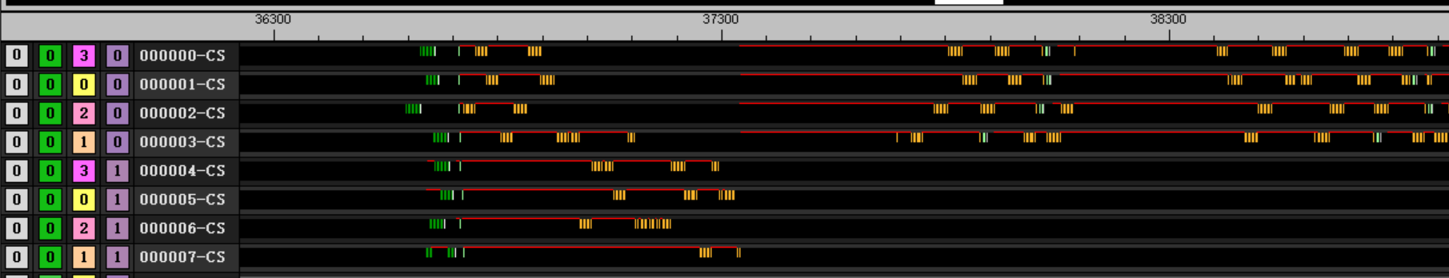
Flat load
kernel
8 wave per CU
60 group
32 flat per loop
Barrier before enter loop
Behavior
47880 clk for non-block wave
56108 clk for block wave
Switch to block wave till first wave finished
flat_load_dword v[v_test+ 0], v[v_addr_a:v_addr_a + 1] offset:4* 0
flat_load_dword v[v_test+ 1], v[v_addr_a:v_addr_a + 1] offset:4* 1
flat_load_dword v[v_test+ 2], v[v_addr_a:v_addr_a + 1] offset:4* 2
flat_load_dword v[v_test+ 3], v[v_addr_a:v_addr_a + 1] offset:4* 3
flat_load_dword v[v_test+ 4], v[v_addr_a:v_addr_a + 1] offset:4* 4
flat_load_dword v[v_test+ 5], v[v_addr_a:v_addr_a + 1] offset:4* 5
flat_load_dword v[v_test+ 6], v[v_addr_a:v_addr_a + 1] offset:4* 6
flat_load_dword v[v_test+ 7], v[v_addr_a:v_addr_a + 1] offset:4* 7
flat_load_dword v[v_test+ 8], v[v_addr_a:v_addr_a + 1] offset:4* 8
flat_load_dword v[v_test+ 9], v[v_addr_a:v_addr_a + 1] offset:4* 9
flat_load_dword v[v_test+10], v[v_addr_a:v_addr_a + 1] offset:4*10
flat_load_dword v[v_test+11], v[v_addr_a:v_addr_a + 1] offset:4*11
flat_load_dword v[v_test+12], v[v_addr_a:v_addr_a + 1] offset:4*12
flat_load_dword v[v_test+13], v[v_addr_a:v_addr_a + 1] offset:4*13
flat_load_dword v[v_test+14], v[v_addr_a:v_addr_a + 1] offset:4*14
flat_load_dword v[v_test+15], v[v_addr_a:v_addr_a + 1] offset:4*15

Slide 24
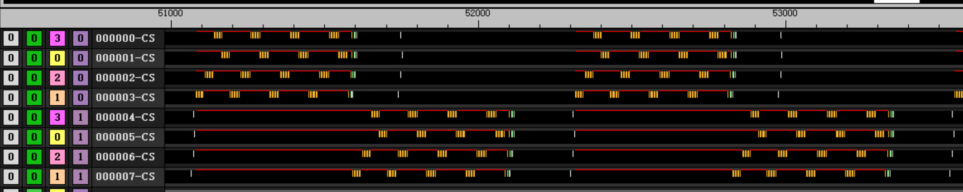
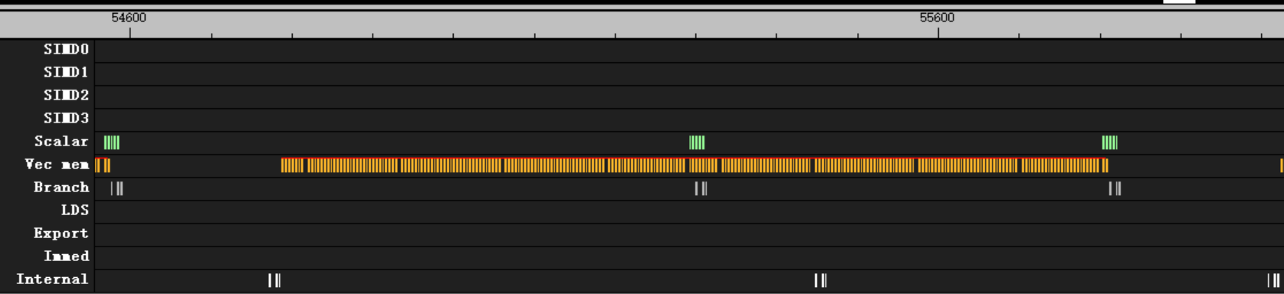
Flat load
flat_load_dword v[v_test+ 0], v[v_addr_a:v_addr_a + 1] offset:4* 0
flat_load_dword v[v_test+ 1], v[v_addr_a:v_addr_a + 1] offset:4* 1
flat_load_dword v[v_test+ 2], v[v_addr_a:v_addr_a + 1] offset:4* 2
flat_load_dword v[v_test+ 3], v[v_addr_a:v_addr_a + 1] offset:4* 3
flat_load_dword v[v_test+ 4], v[v_addr_a:v_addr_a + 1] offset:4* 4
flat_load_dword v[v_test+ 5], v[v_addr_a:v_addr_a + 1] offset:4* 5
flat_load_dword v[v_test+ 6], v[v_addr_a:v_addr_a + 1] offset:4* 6
flat_load_dword v[v_test+ 7], v[v_addr_a:v_addr_a + 1] offset:4* 7
flat_load_dword v[v_test+ 8], v[v_addr_a:v_addr_a + 1] offset:4* 8
flat_load_dword v[v_test+ 9], v[v_addr_a:v_addr_a + 1] offset:4* 9
flat_load_dword v[v_test+10], v[v_addr_a:v_addr_a + 1] offset:4*10
flat_load_dword v[v_test+11], v[v_addr_a:v_addr_a + 1] offset:4*11
flat_load_dword v[v_test+12], v[v_addr_a:v_addr_a + 1] offset:4*12
flat_load_dword v[v_test+13], v[v_addr_a:v_addr_a + 1] offset:4*13
flat_load_dword v[v_test+14], v[v_addr_a:v_addr_a + 1] offset:4*14
flat_load_dword v[v_test+15], v[v_addr_a:v_addr_a + 1] offset:4*15
kernel
8 wave per CU
60 group
32 flat per loop with barrier
Behavior
Total 57780 clk
Switch simd every 4 flat
188 clk after branch
Switch to block wave when first wave doing salu and branch
Switch back till barrier finished

Slide 25
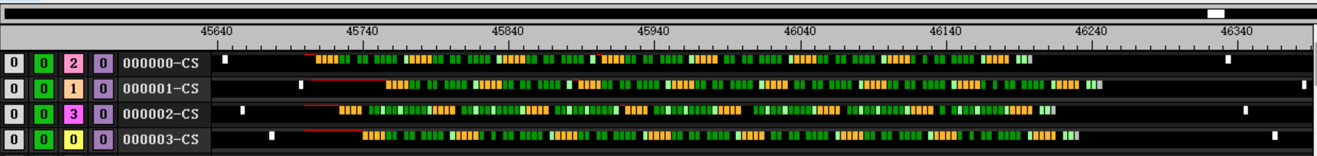
Flat load
flat_load_dword v[v_test+ 0], v[v_addr_a:v_addr_a + 1] offset:4* 0
flat_load_dword v[v_test+ 1], v[v_addr_a:v_addr_a + 1] offset:4* 1
flat_load_dword v[v_test+ 2], v[v_addr_a:v_addr_a + 1] offset:4* 2
flat_load_dword v[v_test+ 3], v[v_addr_a:v_addr_a + 1] offset:4* 3
v_add3_u32 v[v_test+ 8], v[v_test+ 8], v[v_test+ 8], v[v_test+ 8]
v_add3_u32 v[v_test+ 9], v[v_test+ 9], v[v_test+ 9], v[v_test+ 9]
s_add_u32 s[s_test+ 0], s[s_test+ 0], s[s_test+ 0]
v_add3_u32 v[v_test+10], v[v_test+10], v[v_test+10], v[v_test+10]
v_add3_u32 v[v_test+11], v[v_test+11], v[v_test+11], v[v_test+11]
s_add_u32 s[s_test+ 0], s[s_test+ 0], s[s_test+ 0]
v_add3_u32 v[v_test+12], v[v_test+12], v[v_test+12], v[v_test+12]
v_add3_u32 v[v_test+13], v[v_test+13], v[v_test+13], v[v_test+13]
v_add3_u32 v[v_test+14], v[v_test+14], v[v_test+14], v[v_test+14]
v_add3_u32 v[v_test+15], v[v_test+15], v[v_test+15], v[v_test+15]
s_add_u32 s[s_test+ 0], s[s_test+ 0], s[s_test+ 0]
Best practice
4 wave per CU
60 group
32 flat per loop with barrier
8 valu between 4 flat
Behavior
Switch simd every 4 flat
48 clk between every 4 flat per simd
Insert 11 instru. with 4 clk idle between every 4 flat
Use 2 wave per simd to hide branch latency

